Slide 1
Police Fatality | Flee Prediction
Data Science Capstone Project
By, Soundarya

Slide 2
SOURCE | DATA GATHERING
Individuals killed by the US police force(2000-2016) from kaggle dataset
US Population from kaggle
Python | Jupiter Notebook

Slide 3
PROBLEM IDENTIFICATION
To predict the Flee / Not Flee Status

Slide 4
DATA UNDERSTANDING AND CLEANING
More than 12,000 datas with 12 columns
Replacing acronyms to full name of the US states(NY -NEWYORK)
US Population dataset | Merging secondary source- New DataFrame created
Dealing NAN values , NULL values

Slide 5
EXPLORATORY DATA ANALYSIS
Create Visuals to find correlation between Flee and other variables
Making charts and plots to understand different features

Slide 6
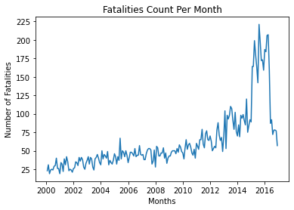
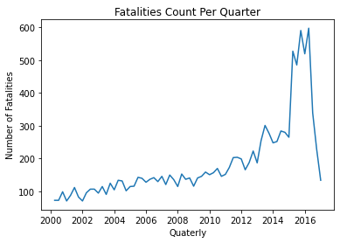
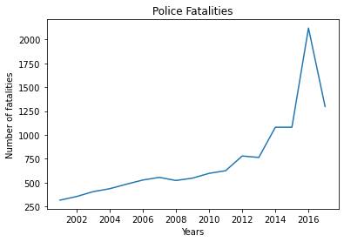
Fatalities Count by Time period graph
of Citizens Killed by the US Police Force (12,000+ People)
zens Killed by the US Police Force (12,000+ People)

Slide 7
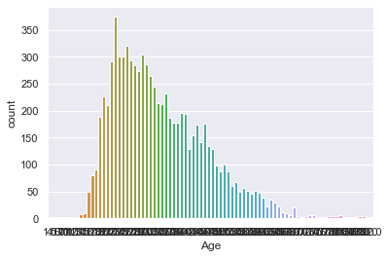
Fatality Count - Age (countplot)

Slide 8
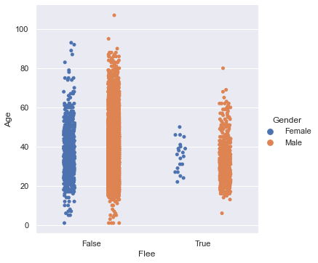
Flee Count - Age -Gender (sns.catplot)

Slide 9
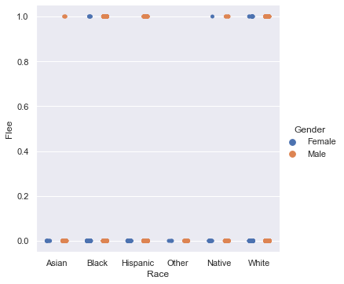
Flee Count - Race - Gender

Slide 10
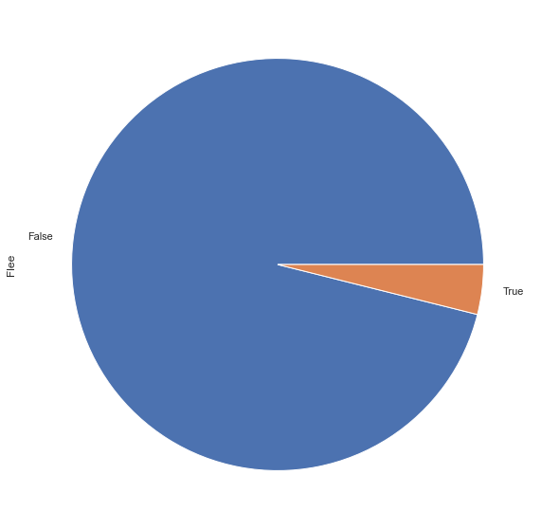
Flee status - pie chart

Slide 11
PRE-PROCESSING AND TRAINING DATA DEVELOPEMENT
Using One hot encoding method for better prediction
Handling NaN values
Data reduction
Splitting the data set in Training and Validation sets
Target Variable is Flee

Slide 12
MODELLING
Creating
Evaluating
Improving

Slide 13
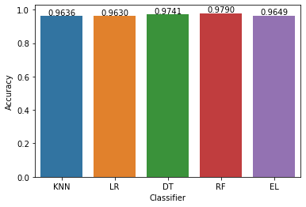
MODELS
Name Score
0 KNN 0.963625
1 LR 0.963009
2 DT 0.974106
3 RF 0.979038
4 EL 0.964858

Slide 14
IMBALANCED DATASET - INITIAL
Random Forrest Accuracy: 96.0
Mean Absoulte Error: 4.0
Classification Report:
precision recall f1-score support
0 0.96 1.00 0.98 1937
1 0.62 0.06 0.10 90
accuracy 0.96 2027
macro avg 0.79 0.53 0.54 2027
weighted avg 0.94 0.96 0.94 2027
Confusion Matrix:
predicted
0 1
actual 0 1934 3
1 85 5

Slide 15
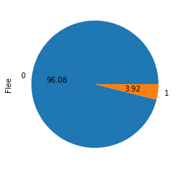
FLEE STATUS

Slide 16
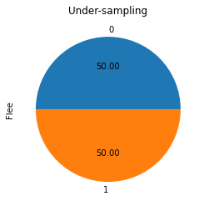

BALANCED DATASET

Slide 17
UNDERSAMPLING METHOD
Random Forrest Accuracy: 74.0
Mean Absoulte Error: 26.0
Classification Report:
precision recall f1-score support
0 0.72 0.75 0.73 75
1 0.77 0.74 0.75 84
accuracy 0.74 159
macro avg 0.74 0.74 0.74 159
weighted avg 0.74 0.74 0.74 159
Confusion Matrix:
predicted
0 1
actual 0 56 19
1 22 62

Slide 18
OVERSAMPLING METHOD
Random Forrest Accuracy: 94.0
Mean Absoulte Error: 6.0
Classification Report:
precision recall f1-score support
0 0.99 0.89 0.94 1928
1 0.90 0.99 0.94 1966
accuracy 0.94 3894
macro avg 0.94 0.94 0.94 3894
weighted avg 0.94 0.94 0.94 3894
Confusion Matrix:
predicted
0 1
actual 0 1721 207
1 24 1942

Slide 19
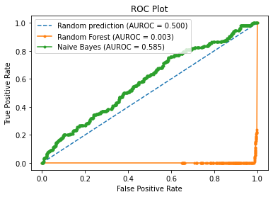
Area Under The Receiver Operating Characteristic Curve

Slide 20
KEY FINDINGS | RECOMMENDATION
Using Undersampling - Oversampling methods for balancing the dataset
Random Forest - Better prediction Model
AUROC Curve - Visualize the prediction
Business Problem solution - Predicting Flee / Not flee

Slide 21
THANK YOU
Data Science Capstone Project
By, Soundarya

